Slide 1
introduction to Data Science
17it111-Krushnal Soni

Slide 2
Introduction of Data Science
Data science is an inter-disciplinary field that uses scientific methods, processes, algorithms and systems to extract knowledge and insights from many structural and unstructured data. Data science is related to data mining, deep learning and big data.
Data science is a "concept to unify statistics, data analysis, machine learning, domain knowledge and their related methods" in order to "understand and analyze actual phenomena" with data.It uses techniques and theories drawn from many fields within the context of mathematics, statistics, computer science, domain knowledge and information science.

Slide 3
WEEk 1 : Python Fundamentals
Python Strings :-
In Python, Strings are arrays of bytes representing Unicode characters. However, Python does not have a character data type, a single character is simply a string with a length of 1. Square brackets can be used to access elements of the string.
Python Lambda Functions:-
Python allows you to create anonymous function i.e function having no names using a facility called lambda function. Lambda functions are small functions usually not more than a line. It can have any number of arguments just like a normal function. ... Also there is no need for any return statement in lambda function.

Slide 4
NumPy & Pandas :-
1) Numpy
Python programming language, adding support for large, multi-dimensional arrays and matrices, along with a large collection of high-level mathematical functions to operate on these arrays.
2)Pandas
Pandas is a high-level data manipulation tool developed by Wes McKinney. It is built on the Numpy package and its key data structure is called the DataFrame. DataFrames allow you to store and manipulate tabular data in rows of observations and columns of variables.
Map Function():-
Python map() function
map() function returns a map object(which is an iterator) of the results after applying the given function to each item of a given iterable (list, tuple etc.) Parameters : fun : It is a function to which map passes each element of given iterable. iter : It is a iterable which is to be mapped.

Slide 5
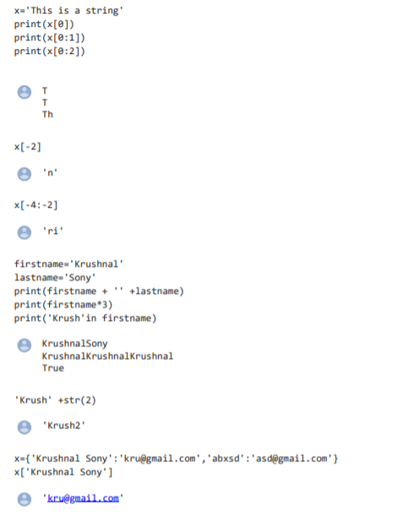
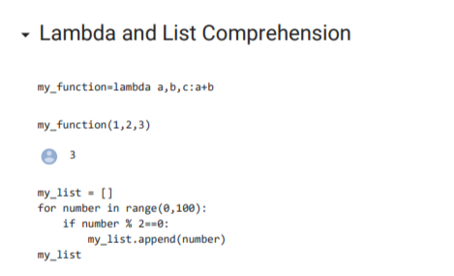
Screenshots:-

Slide 6
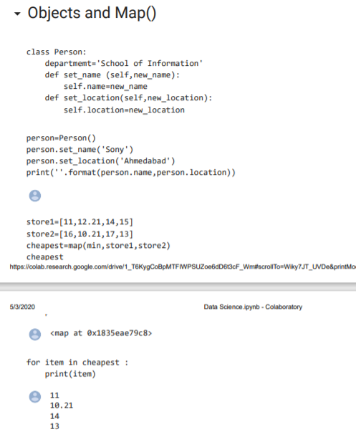
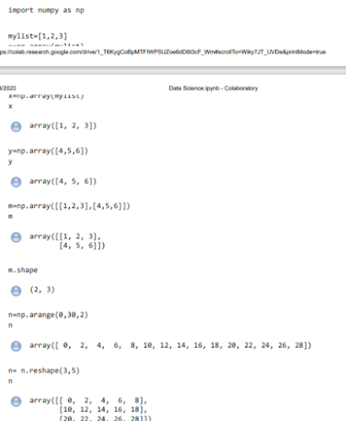

Slide 7
Week 2 :- Basic DataProcessing with pandas
Series Datastructure:-
Python Pandas - Series. Series is a one-dimensional labeled array capable of holding data of any type (integer, string, float, python objects, etc.). The axis labels are collectively called index.
Querying Series in Python:-
Python is a great language for doing data analysis, primarily because of the fantastic ecosystem of data-centric Python packages. Pandas is one of those packages that makes importing and analyzing data much easier.
Analyzing data requires a lot of filtering operations. Pandas provide many methods to filter a dataframe and Dataframe.query() is one of them.

Slide 8
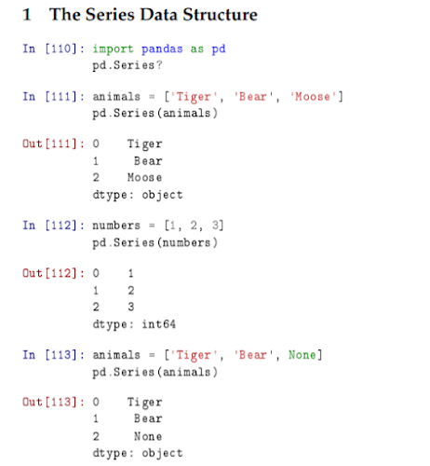
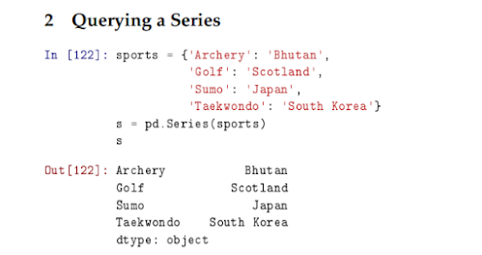

Slide 9
Dataframe DataStructures:-
Pandas DataFrame is two-dimensional size-mutable, potentially heterogeneous tabular data structure with labeled axes (rows and columns). A Data frame is a two-dimensional data structure, i.e., data is aligned in a tabular fashion in rows and columns. Pandas DataFrame consists of three principal components, the data, rows, and columns.
Querying a DataFrames:-
The query() function is used to query the columns of a DataFrame with a boolean expression. The query string to evaluate. You can refer to variables in the environment by prefixing them with an '@' character like @a + b. New in version 0.25.

Slide 10
Dataframe Loading :-
Load the Pandas libraries with alias 'pd'
import pandas as pd.
Read data from file 'filename.csv'
Control delimiters, rows, column names with read_csv
data = pd.
Preview the first 5 lines of the loaded data.
Indexing DataFrames:-
Describe what 0-based indexing is.
Manipulate and extract data using column headings and index locations.
Employ slicing to select sets of data from a DataFrame.
Employ label and integer-based indexing to select ranges of data in a dataframe.
Reassign values within subsets of a DataFrame.

Slide 11
Week 3:-Advanced Python Pandas
Merging Dataframes:-
Dataframes together to form your analysis dataset. Merging and joining dataframes is a core process that any aspiring data analyst will need to master. This blog post addresses the process of merging datasets, that is, joining two datasets together based on common columns between them.
Group by:-
Pandas dataframe groupby() function is used to split the data into groups based on some criteria. pandas objects can be split on any of their axes. The abstract definition of grouping is to provide a mapping of labels to group names.
Scales:-
Feature Scaling or Standardization: It is a step of Data Pre Processing which is applied to independent variables or features of data. It basically helps to normalise the data within a particular range. Sometimes, it also helps in speeding up the calculations in an algorithm.

Slide 12
Pivot Tables:-
A pivot table is a similar operation that is commonly seen in spreadsheets and other programs that operate on tabular data. The pivot table takes simple column-wise data as input, and groups the entries into a two-dimensional table that provides a multidimensional summarization of the data.
Data Functionality:-
Let's take a look at the most important built-in Python functions:
print() We have already used print() .
abs() returns the absolute value of a numeric value (e.g. integer or float).
round() returns the rounded value of a numeric value.
min() , sorted() , sum() , len() , type()

Slide 13
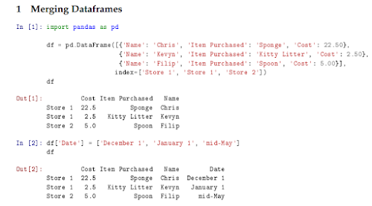
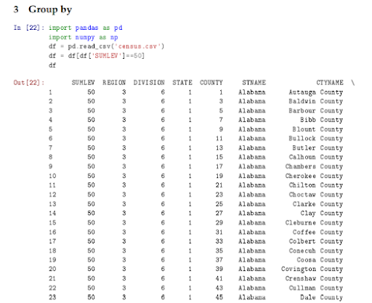
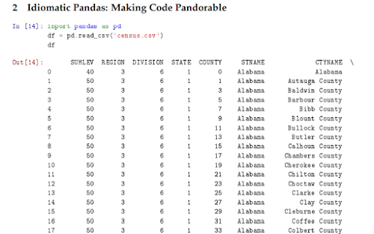

Slide 14
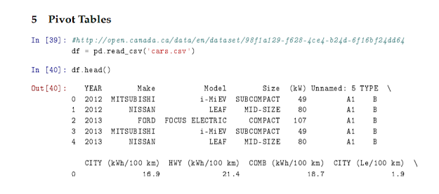
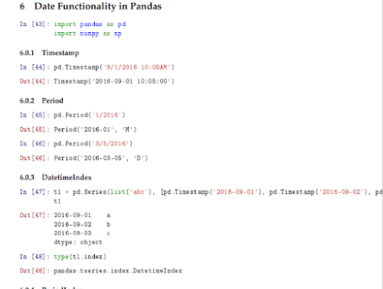

Slide 15
Week 4:-Statistical analysis in python
Distribution:-
Python normal distribution is a function that distributes random variables in a graph that is shaped as a symmetrical bell. It does so by arranging the probability distribution for each value.
Hypothesis testing in Python:-
Simple and intuitive functions exist in Python packages such as Scipy or Statsmodels. Run the test with the chosen function and examine the p-value and reject/fail to reject the null hypothesis accordingly. Understand the true meaning of p-value.
Hypothesis is an advanced testing library for Python. It lets you write tests which are parametrized by a source of examples, and then generates simple and comprehensible examples that make your tests fail. This lets you find more bugs in your code with less work.

Slide 16
